Slide 1
TRAINING ACTIVITIES, PROGRAMS UPDATE & OUTLOOK
PARTNER. SHIP. REDEFINED.
PDB-03-000

Slide 2
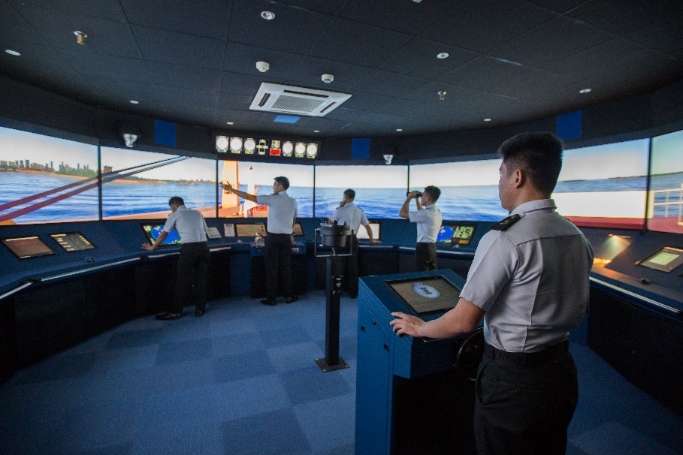
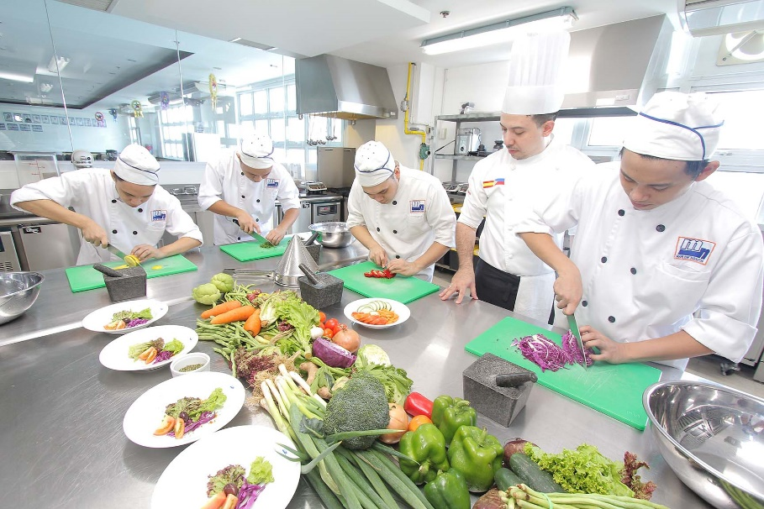
TRAINING PROGRAMS UPDATE
PHILIPPINES
Intake of deck and engine cadets from college
Additional shore-based training at our training facilities in Manila (United Marine Training Center/UMTC)
First assignment as Cadet B – familiarization with vessel environment
Second assignment as Cadet A – introduction to duties of operational level officer/engineer
Intake of cook trainees from hotel & restaurant colleges
Four months shore-based training at UMTC
Familiarization training on board in the rank of cook trainee with experienced cook for a period of approx. 2 months
Take over as cook – provided qualified and recommended by ship’s command
Full mission bridge simulator training
Culinary training - Nutritional Balanced Healthy Menu

Slide 3
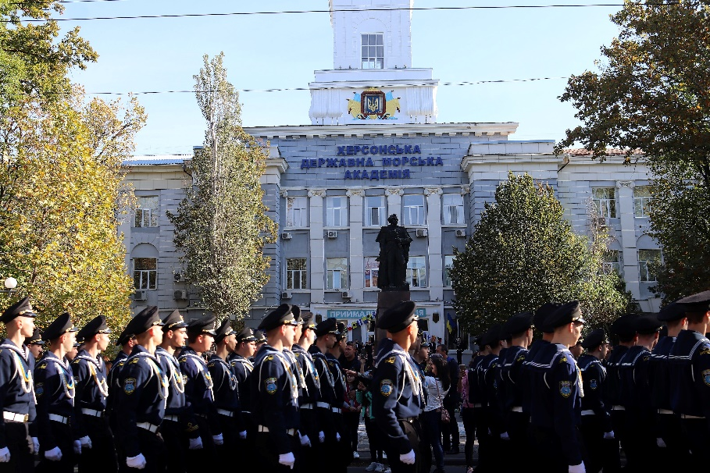
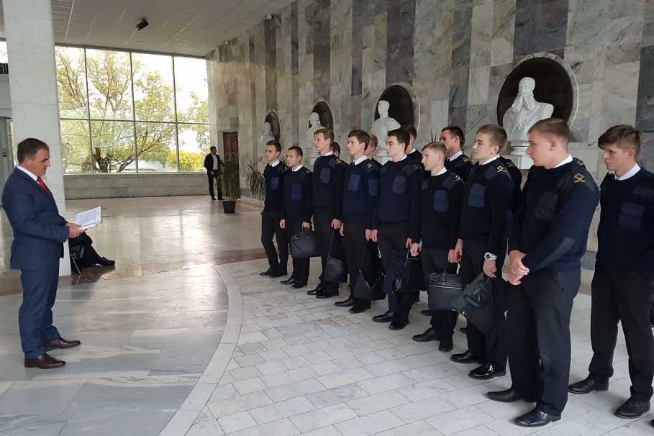
TRAINING PROGRAMS UPDATE
UKRAINE
RUSSIA
Partnership with Kherson State Maritime Academy/KSMA
Intake of deck cadets from college and academy and engine and electrical cadets from academy
First assignment as cadets – familiarization with vessel environment
Second assignment as rating O/S or wiper; electrical cadets both practice assignments in the rank of cadet – introduction to duties of operational level officer/engineer
Intake of deck and engine cadets from Admiral Ushakov Maritime State University/AUMSU in Novorossiysk
First assignment as Cadet B – familiarization with vessel environment
Second assignment as Cadet A – introduction to duties of operational level officer/engineer
Annual inauguration event at KSMA, Ukraine
Selection of cadets from AUMSU, Russia

Slide 4
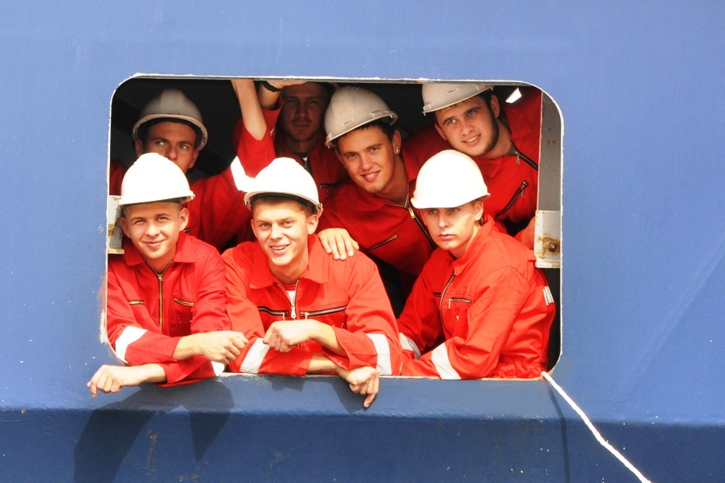
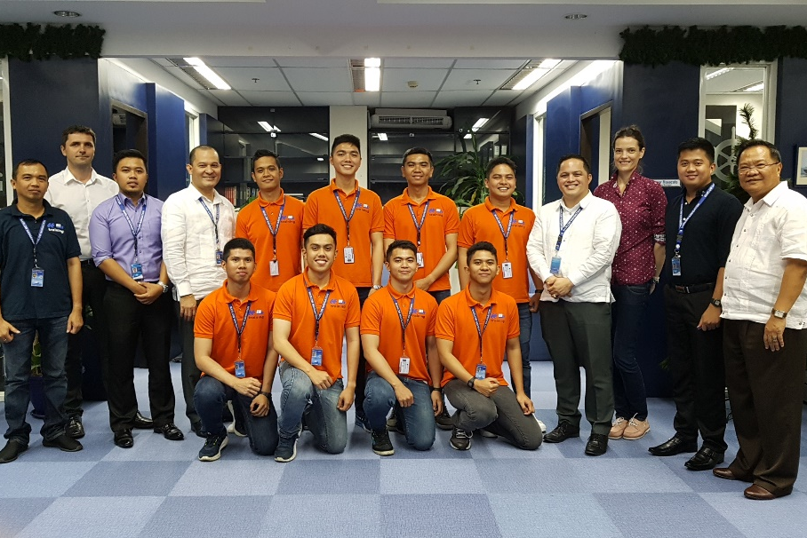
TRAINING PROGRAMS UPDATE
SHIPBOARD SUPPORT FOR THE CADETS AND COOK TRAINEES
EXPECTATIONS TOWARDS THE CADETS/TRAINEES
Create opportunities to get familiarized with different aspects and task of the job
Provide familiarization and monitoring – particularly for assignments without previous experience
Support through constructive feedback and guidance
Follow up on status of training progress documentation
Objective performance reports indicating the potential to become a good deck officer/engineer/cook
Display of willingness, interest, initiative and motivation
Active involvement
Maintenance of the training progress documentation (ISF Training Record Book, project works, monthly progress report)
Open to constructive criticism
Cadets gaining invaluable experience on board dedicated training vessel
Marlow cadets completing their training on board Hapag Lloyd vessel

Slide 5
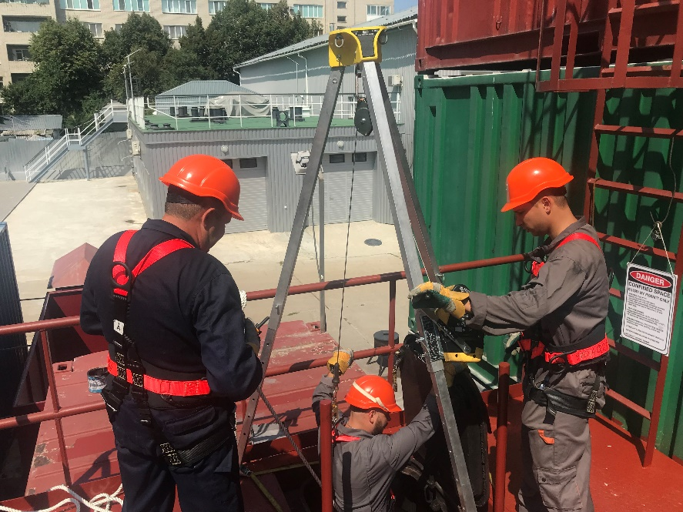
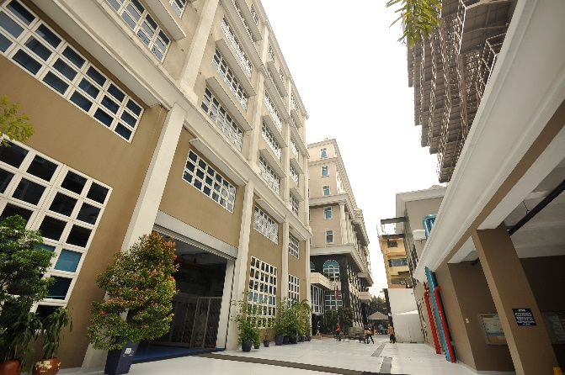
TRAINING ACTIVITIES
TRADITIONAL TRAINING PROVIDERS
CURRENT & FUTURE CHALLENGES
United Marine Training Center in the Philippines for class room, simulator, workshop and hands on training
Kherson Maritime Specialized Training Centre in Ukraine for classroom and simulator training
Training Centre at Admiral Ushakov Maritime State University in Novorossiysk/Russia for classroom and simulator training
Marlow Navigation Ukraine for Classroom training
Seagull for self-paced computer-based training, access for all crew via STA
SafeBridge for ECDIS type specific training and SafeMetrix/assessment of soft skills and cognitive abilities
Continuous need to keep crew up-to-date and trained with regards to new regulations and technologies
Training of crew without direct access to classroom/simulator training
Impact of CORONA virus on travel arrangements and attendance training (social distancing)
State-of-the-art UMTC training facility
Work Permit, Enclosed Space Entry & Rescue at KMSTC

Slide 6
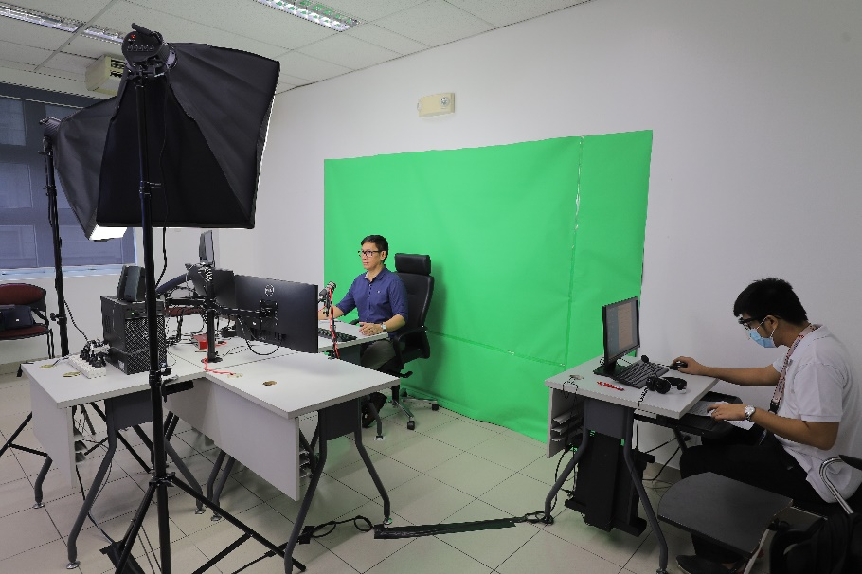
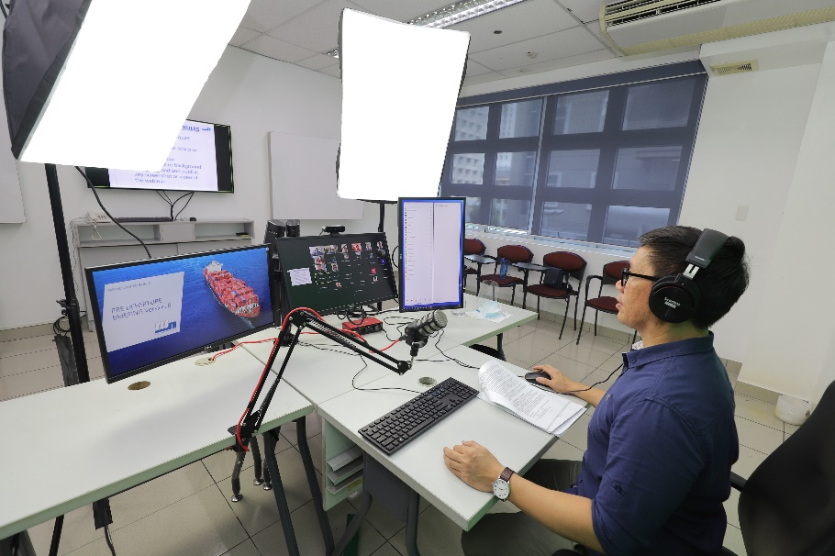
TRAINING ACTIVITIES
SOLUTIONS
Enhancement of distant learning offers, e.g. by webinars, virtual classroom, creation of self-paced e-learning content
Mixture of different learning methods, e.g. introductory webinar plus self study plus simulator exercise and final assessment at training centre
Use of new technologies replacing/complementing attendance courses (cloud based simulators, augmented and virtual reality)
Introduction of easy access to the different training solutions, scheduling and administration, follow up of progress
UMTC and KMSTC already offering webinars (Guidance to Port State Control, Safety Awareness, Anti-Piracy, Pre-Departure Briefing) – more under development (fuel management, draft survey, …)
Various distant learning courses already well developed & under way at our key training centres

Slide 7
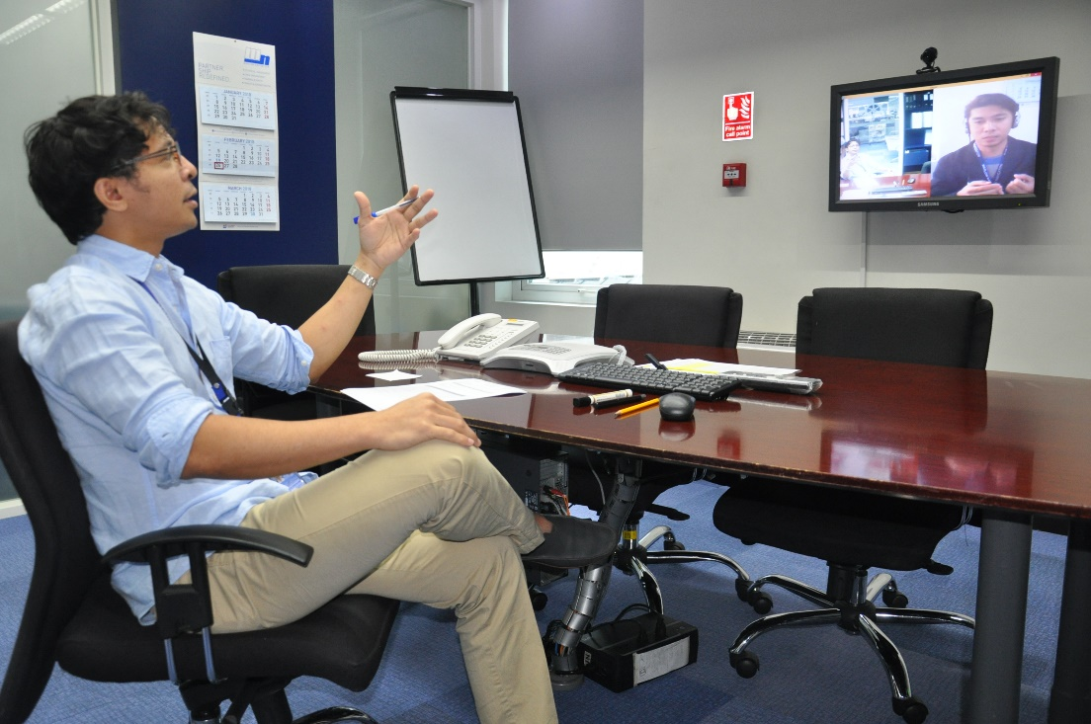
TRAINING ACTIVITIES
OPPORTUNITIES & CHALLENGES
Ability to pass certain training remotely from home
Higher level of flexibility
Providing training to crew from locations presently not being covered
Reduction of travel related costs
More time at home with family
BUT
Necessity to stick to times for webinars, virtual classroom or other sessions with instructor
High level of self-motivation, as less strict control
Openness to new learning methodologies and techniques
Ability to conduct self-studies
Technical set up (computer, stable internet connection)
Remote learning initiatives are both a solution to the current situation but also provide additional benefits for crew and company

Slide 8
UPGRADING TRAINING Training courses introduced in 2020 or with planned implementation during 2021
Course Name | PHL | UKR | RUS
Marine Fuel Management for Management Level Engineers | UMTC | KMSTC | AUMSU
Enclosed Space Entry | UMTC | KMSTC
Guidance to Port State Control Inspections – reviewed class room training | UMTC | KMSTC
Guidance to Port State Control Inspections - webinar | UMTC | KMSTC | KMSTC
Safety Awareness Training - webinar | UMTC | KMSTC | KMSTC
Conversion of various classroom attendance courses into distant learning courses | UMTC | KMSTC | KMSTC
ECDIS with passage planning | UMTC | KMSTC | AUMSU
Marked in BLACK = already existing before 2020
Marked in BLUE = introduced in 2020
Marked in RED = planned for 2021

Slide 9
THANK YOU!

Slide 10
DISCLAIMER
Content within this presentation is for preliminary informational purposes only and should not be regarded as offering a complete and final explanation/advice of all content and material referred.
This document contains data and information provided as seen, and at the time of production. Marlow Navigation reserves the right to amend/update such content based on new data and information in order to be most relevant at a given period, and as such, assumes no liability for accuracy of content within. Such is the nature of the maritime industry, that commercial figures and KPIs are dynamic and changing on a regular basis.
Copyright Notice
Material, content and work found on this Marlow Navigation presentation is copyright to Marlow Navigation Co Ltd.
Content & Data

